Slide 1
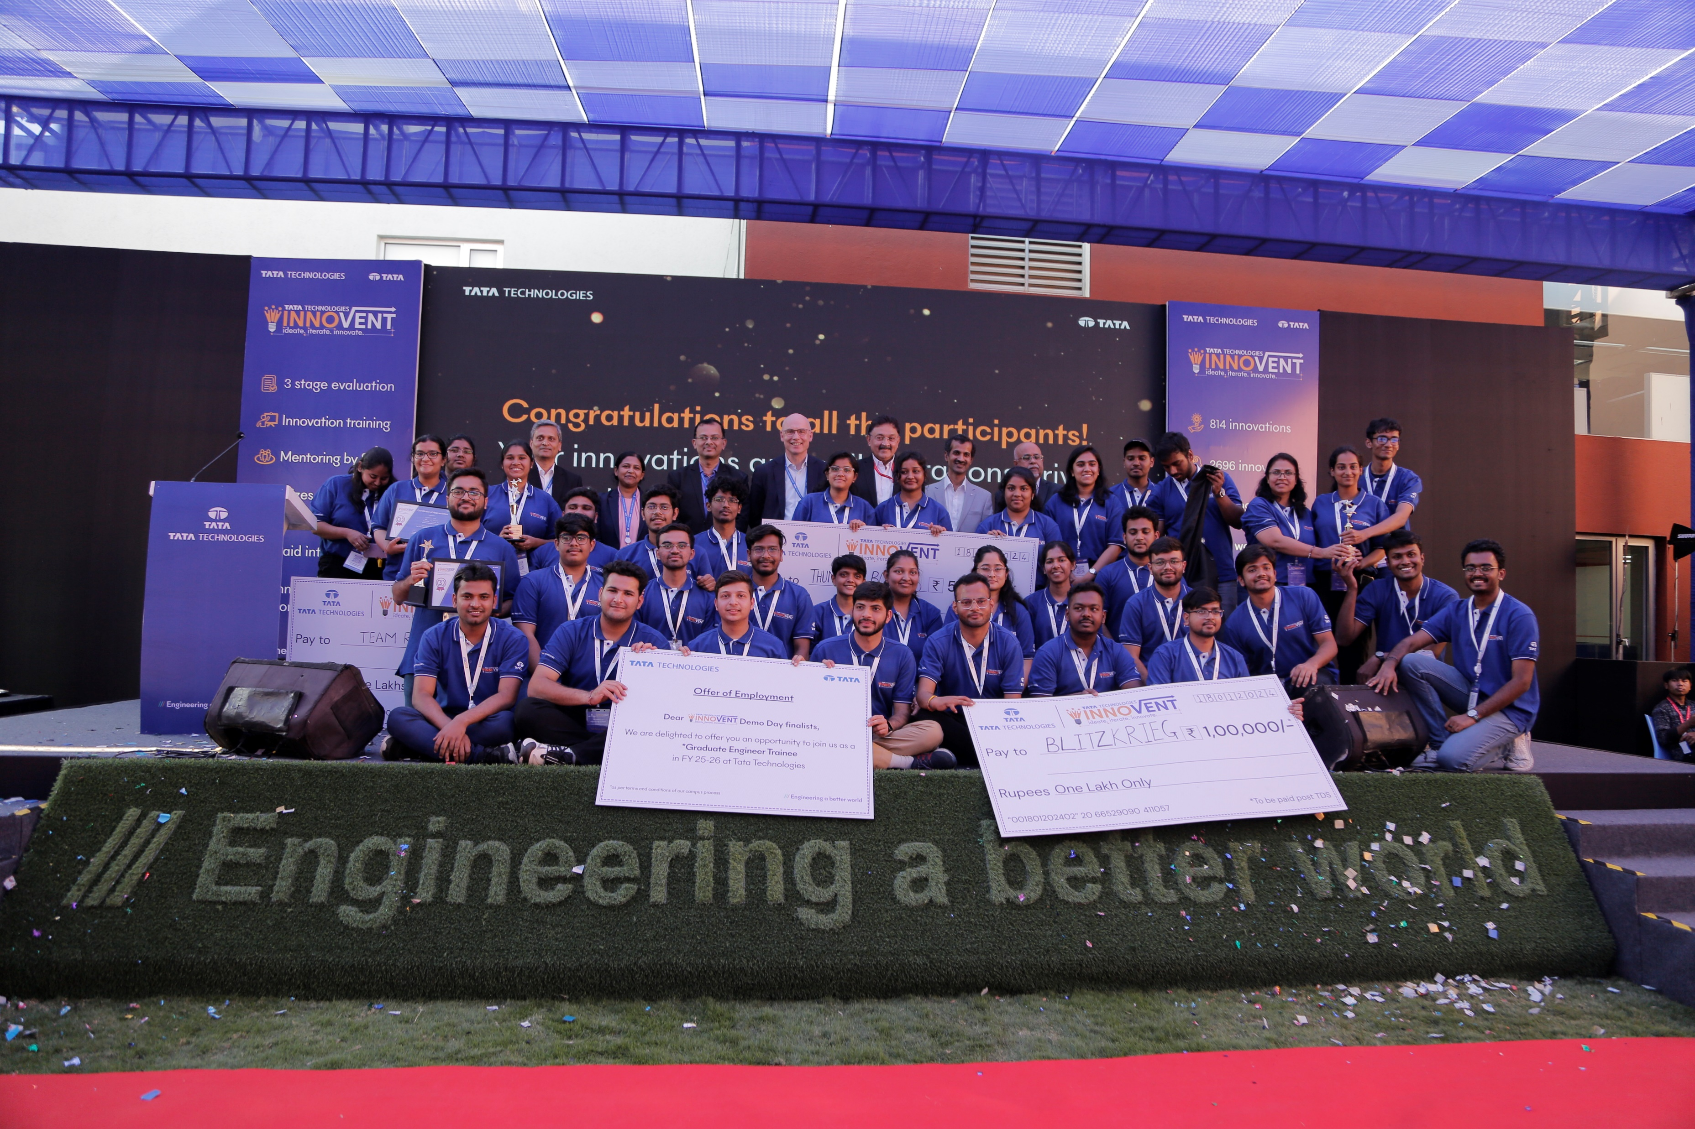
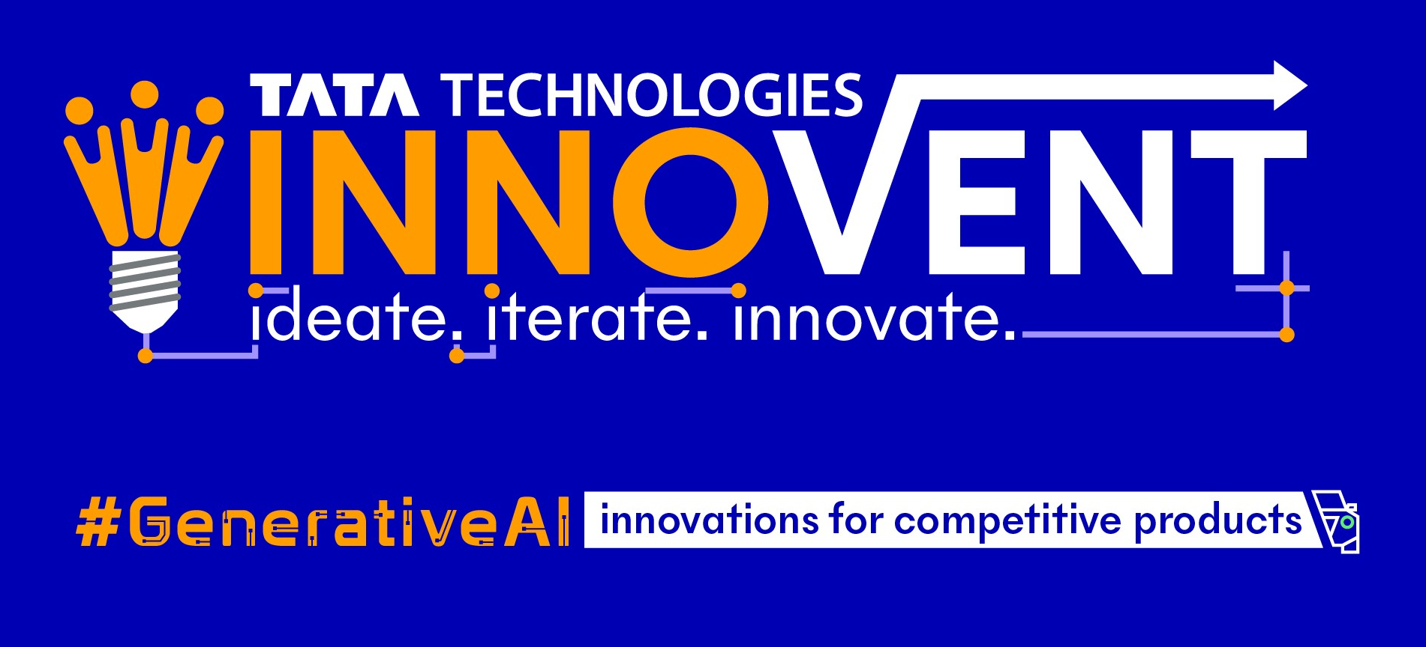
Stage 2 presentation template
Aug 24

Slide 2
Stage 2 Presentation content
The supporting presentation must cover dedicated slides on the below content:
Problem Statement
Objective and Approach
Solution Overview
Solution Architecture
Challenges Faced
Technical Implementation
Code Contributions i.e. custom algorithms, machine learning models, and integrations unique to your project.
Results and Achievements
Demonstration video
Link to access the source code
Future Enhancements that the team has planned for stage-3 Final demo day round
Project Plan for POC completion by stage-3 Final demo day round in Jan-25

Slide 3
Introduction
Team Name: Oblivion
Team Member Roles
Member 1
Mukand Jirawla (Leader & Backend Developer)
Email: mukandjain108@gmail.com mukandjain108@gmail.com
Phone: 9462278187
University: M.B.M. University
Member 2
Bhavesh Lakhujani (Idea Contributor and AI Coder)
Email: bhaveshlakhujani@gmail.comaveshlakhujani@gmail.com
Phone: 9587985682
University: M.B.M. University
Member 3
Saurav Soni (Frontend Developer & Cloud Computing)
Email: saurav22026@gmail.comnisaurav941@gmail.com
Phone: 6377156808
University: IIT Jodhpur
Brief background of team Members:
Mukand Jirawla specializes in backend development and technical leadership.
Bhavesh Lakhujani has expertise in AI coding and generated the project idea.
Sourav Soni brings experience in frontend development and cloud technologies.

Slide 4
Problem statement
Automated model G-code generation for 3D designs in CNC machining using Gen AI.
Real Time Challenges in Manufacturing Industry
Manual G-code generation in CNC machining is prone to errors and inefficiencies, requiring skilled operators.
These inefficiencies lead to longer production times, increased costs, and suboptimal machine performance.
There is a need for an automated, AI-driven solution to generate optimized G-code, reducing human intervention and errors.
Market Size and Growth Potential
The global CNC machine market, valued at $81.95 billion in 2022, is projected to grow at a 5.7% CAGR (2023-2030). As industries like aerospace, automotive, and electronics expand, the demand for precision and efficiency in manufacturing increases. Integrating Generative AI for G-code automation aligns with Industry 4.0, offering significant potential to enhance manufacturing processes, reduce costs, and boost scalability..

Slide 5

Objective and Approach
Develop an automated system to generate optimized G-code for CNC machining using Generative AI, allowing users to streamline the conversion of 3D designs into machine-ready code. This solution aims to reduce human errors, improve precision, and enhance production efficiency in manufacturing.
APPROACH
Model Selection:
Identify and fine-tune a state-of-the-art deep learning model, such as Stable Diffusion, to generate optimized G-codes from 3D designs for CNC machining.
Data Collection:
Gather a dataset of 2D images with various objects and dimensions to train the model for accurate dimension prediction and G-code generation.
Database Management: Use MongoDB to store and retrieve 3D design inputs, predicted object dimensions, and generated G-codes efficiently.
Performance Optimization:
Optimize the performance of the model to handle large-scale data, ensuring fast and accurate dimension prediction and G-code generation for real-time manufacturing processes.
User Interface:
Develop a user-friendly web interface where users can upload 2D designs and receive G-codes, enabling easy adoption by manufacturing industries and operators.
Model Integration:
Integrate the trained model into a web-based platform for seamless conversion of 2D designs into G-codes, automating CNC machining

Slide 6
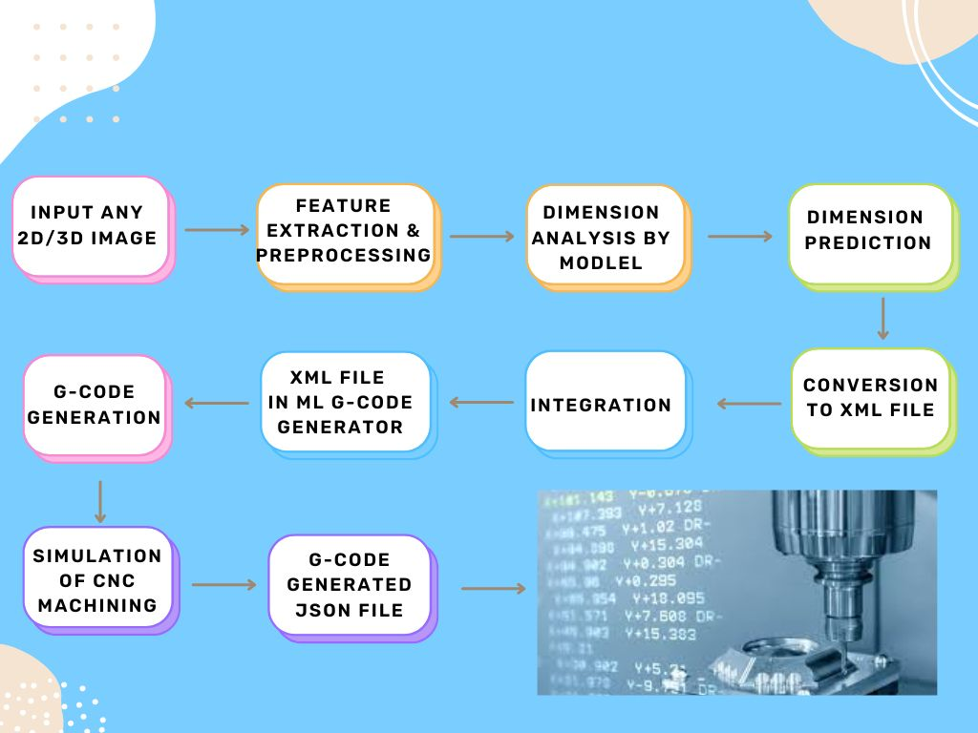
Solution Overview

Slide 7
Solution Overview
Utilizing Generative AI to automate the process of G-code generation for CNC machining.
Enhancing precision and efficiency by predicting exact object dimensions from 2D images.
Reducing manual intervention, thus minimizing errors in the G-code creation process.
Providing a user-friendly interface that simplifies the input of 2D images and generates optimized G-code.
Streamlining CNC machining workflows, leading to faster and more accurate production.
Components
Generative AI Model: The AI model analyzes 2D images and predicts object dimensions, converting them into an XML file for use in G-code generation. This step eliminates the need for manual dimension estimation and coding.
XML-Based G-code Generator: The generated XML file is processed by the G-code generator, transforming object dimensions into machine-readable G-code, which is directly utilized by CNC machines.
User Interface: A simple, intuitive interface allows users to upload 2D images and receive G-code as output, making it easy for operators to integrate the tool into existing CNC workflows

Slide 8
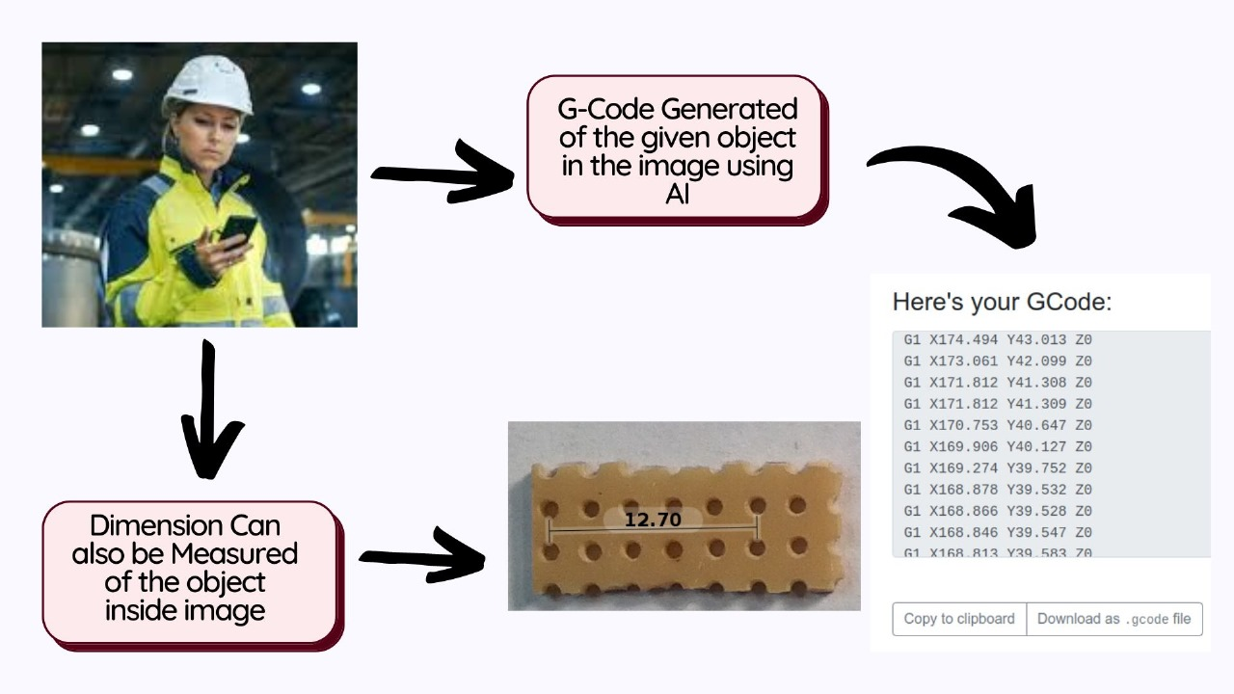
Technical Implementation
Technologies & Tools
Convolutional Neural Networks (CNN): Core for extracting precise object dimensions from 2D images.
Generative AI Models: Automates G-code generation from the predicted dimensions and 3D models.
Python (Flask Framework): Manages backend operations and API integration for seamless model communication.
TensorFlow: Used for training deep learning models and optimizing predictions.
MongoDB: Stores user inputs, predicted dimensions, and G-code outputs for efficient data retrieval.
XML Formatter: Converts dimensional data into an XML file for structured output.
CNC Simulators: Validates the efficiency of the generated G-code.

Slide 9



Technical Implementation
Implementation Flow
2D Image Processing
CNN processes the input image to predict dimensions with high accuracy.
Real-time Performance
The Flask-based web app provides a seamless interface for users to generate G-code on demand.
Dimension-to-G-code Pipeline
AI-driven system converts dimensions into a 3D model and generates optimized G-code.
Data Handling
MongoDB manages all input/output data, including user prompts, dimension predictions, and generated code.

Slide 10
Technical Implementation
Challenges Addressed
Dimension Prediction Accuracy: Enhanced through fine-tuning deep learning models and using diverse training datasets.
G-code Optimization: Solved using iterative model refinements and performance benchmarking with CNC simulators.
Scalability & Flexibility:
Cloud-Ready: Architecture designed to scale using cloud platforms (AWS/GCP) for larger datasets and faster processing.
Modular System: Flexible integration of future enhancements like multi-object recognition and support for various CNC machine types.

Slide 11
Novelty
Current Solutions: Existing CNC machining tools focus on manual or semi-automated G-code generation, often requiring human expertise in interpreting design files.
Generative AI Applications: While generative AI has been explored in fields like design and art, its direct application in automating G-code generation for CNC machining is limited in published literature.
Unique Aspects of Our Solution
Full Automation from Design to G-Code: Unlike current methods, our solution automates the entire process from 2D image input to G-code output using Generative AI, eliminating the need for manual intervention.
AI-Powered Dimensional Predictions: The novelty lies in our use of AI to predict object dimensions accurately from 2D images—an area not explored by competitors.
Custom XML and G-Code Generator: Our solution’s ability to convert dimensional data into optimized G-code for CNC machines offers a seamless and efficient workflow that is difficult to replicate without deep technical expertise in AI and machining.

Slide 12
Novelty
Key Differentiators & Competitor Benchmarking:
Competitor Solutions:
Competitor A: Uses semi-automated G-code generation based on 3D models, requiring manual intervention for dimension verification.
Competitor B: Provides CAD/CAM software with some level of automation, but still dependent on human interaction for generating final G-code.
Our Solution:
Fully Automated: From 2D image input to G-code output with zero manual steps.
Accuracy: AI-driven dimension predictions ensure precise machining, reducing errors.
Scalability: Adaptable to various CNC machines and manufacturing environments.
Efficiency: Generates optimized G-code in real-time, drastically reducing time-to-production.

Slide 13
Novelty
Benchmarking & Top Features:
Feature | Competitor A | Competitor B | Our Solution
Full Automation | ✖️ | ✖️ | ✔️
Generative AI Dimensioning | ✖️ | ✖️ | ✔️
Real-time G-Code Generation | ✖️ | ✔️ | ✔️
Compatibility with Multiple CNC Machines | ✔️ | ✔️ | ✔️
Error Minimization | ✖️ | ✔️ | ✔️
Backing Our Novelty:
We conducted a prior art search and found limited applications of Generative AI in CNC machining for G-code generation.
Our AI-powered dimension extraction from 2D images offers a unique capability that cannot be easily copied or replicated by competitors.
Competitor benchmarking reveals our edge in automation, accuracy, and flexibility, setting our solution apart in the market.

Slide 14
Challenges Faced
Code Integration Complexity
Challenge: Difficulty merging dimensional analysis with G-code generation modules.
Solution: Created a unified data pipeline.
Lesson: Early modular design is essential.
Dimension Prediction Accuracy
Challenge: Low accuracy for complex object shapes.
Solution: Expanded dataset and applied advanced image preprocessing.
Lesson: Diverse data improves model performance.
G-Code Optimization
Challenge: Inefficient G-code for various CNC machines.
Solution: Refined algorithm with iterative testing and reinforcement learning.
Lesson: Continuous testing is crucial for optimal results.
User Interface Design
Challenge: Balancing simplicity with advanced features.
Solution: Designed a tiered UI with basic and advanced options.
Lesson: User-centered design ensures broad usability.

Slide 15
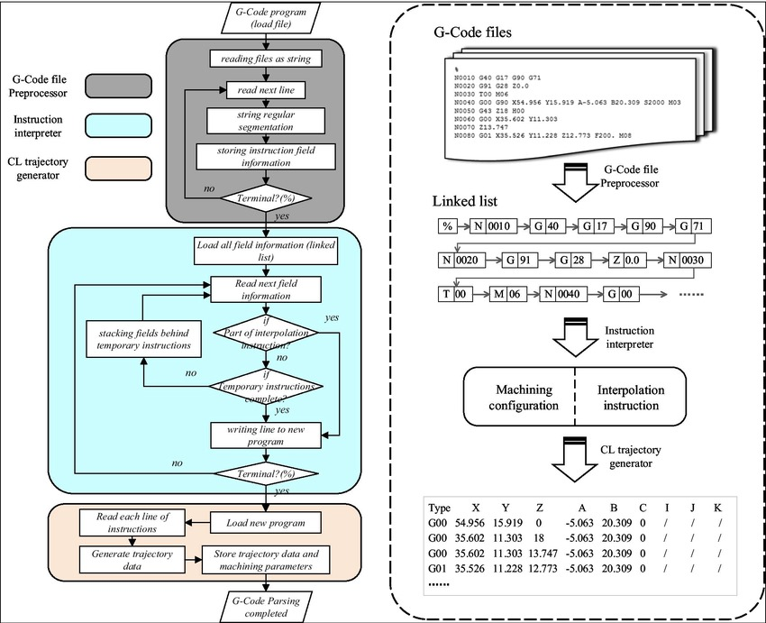
Results and Achievements
90%+ Accuracy in Dimension Prediction
Impact: Higher precision in CNC machining.
20% More Efficient G-Code
Impact: Reduced material waste and machining time.
Seamless System Integration
Impact: Automated workflow with minimal manual intervention.
User-Friendly Interface
Impact: Accessible CNC machining for users of all expertise level
Scalable System Design
Impact: Adaptable to multiple CNC machines and diverse applications

Slide 16
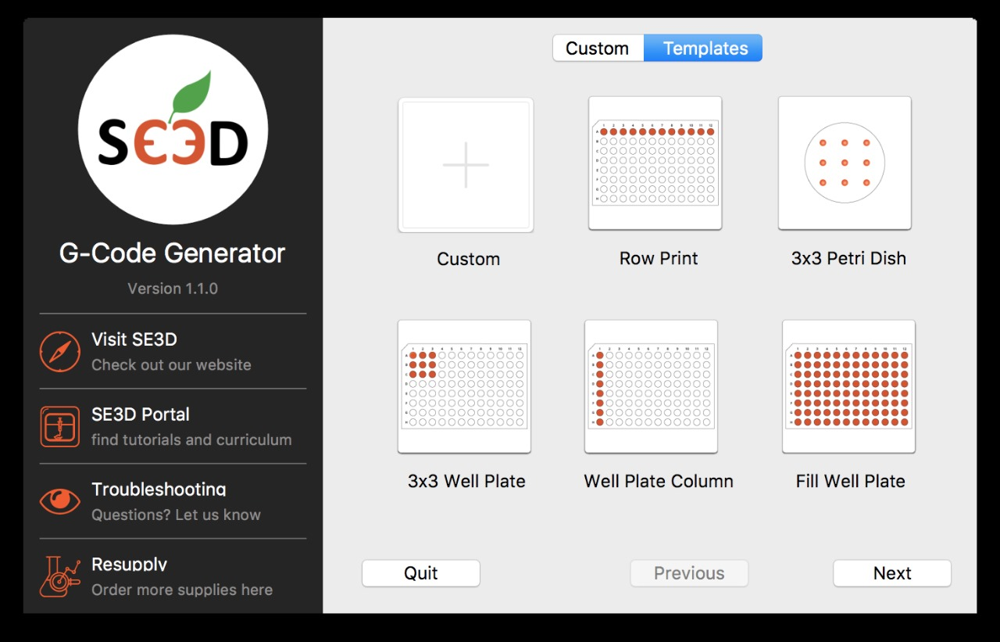
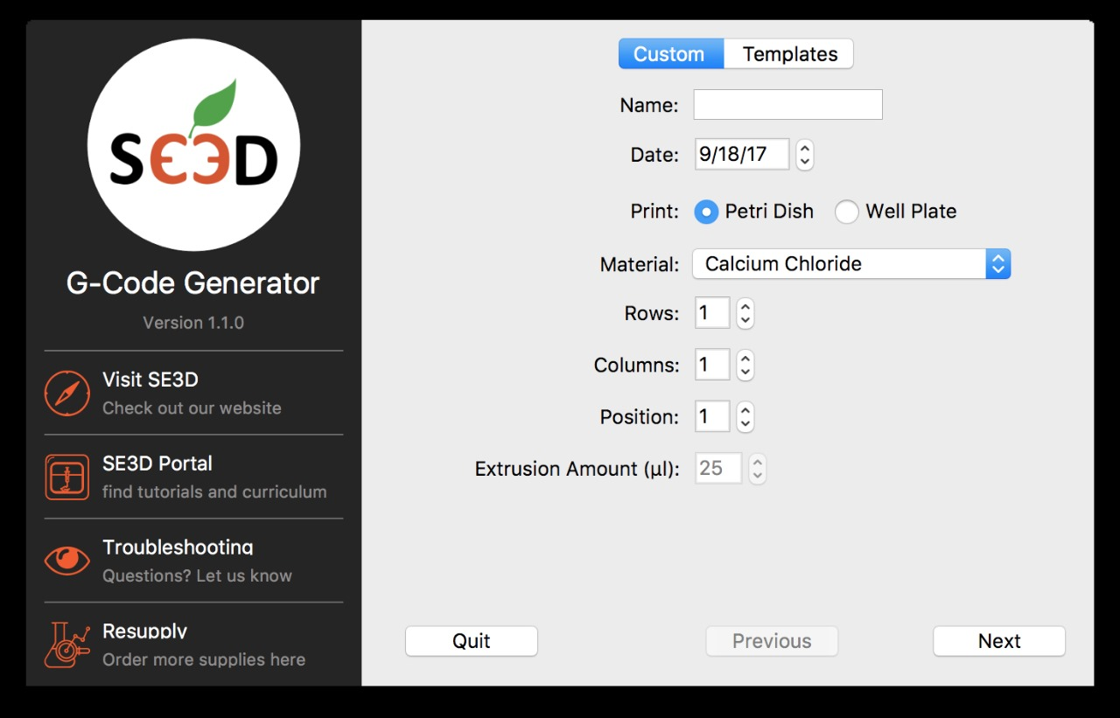
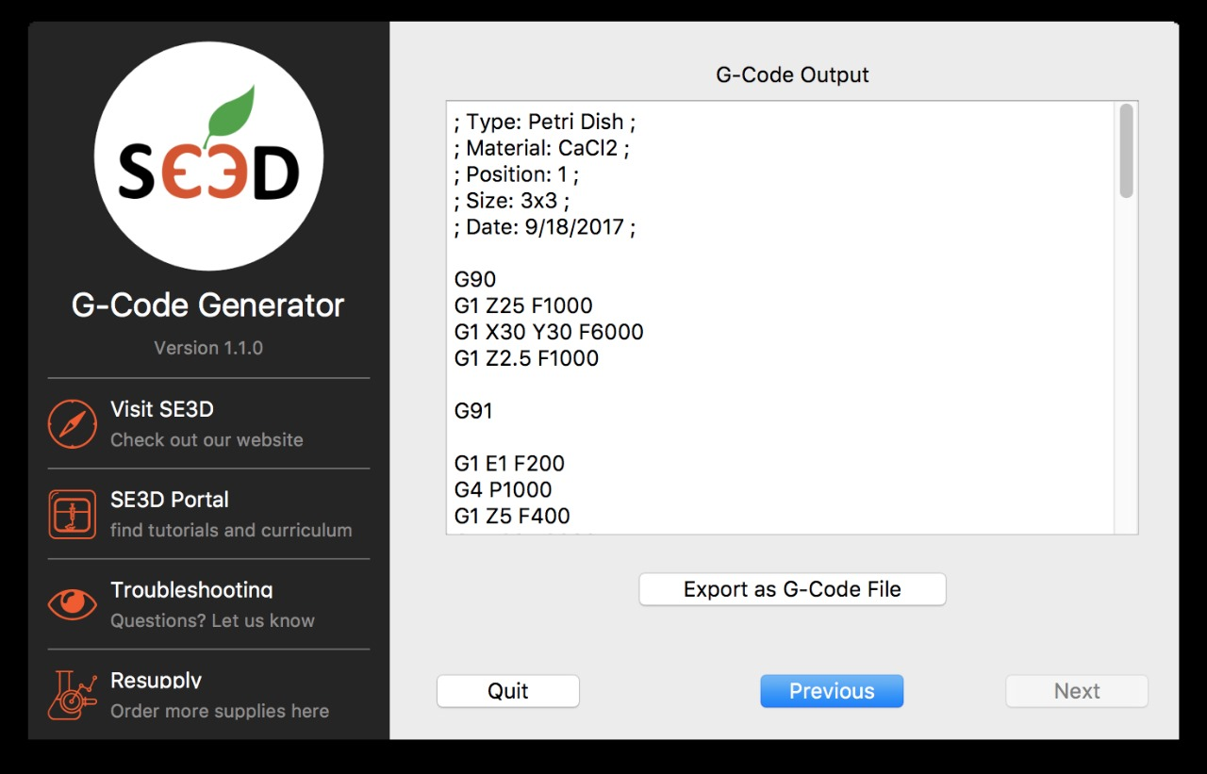
Demonstration of POC/prototype with videos, photos

Slide 17

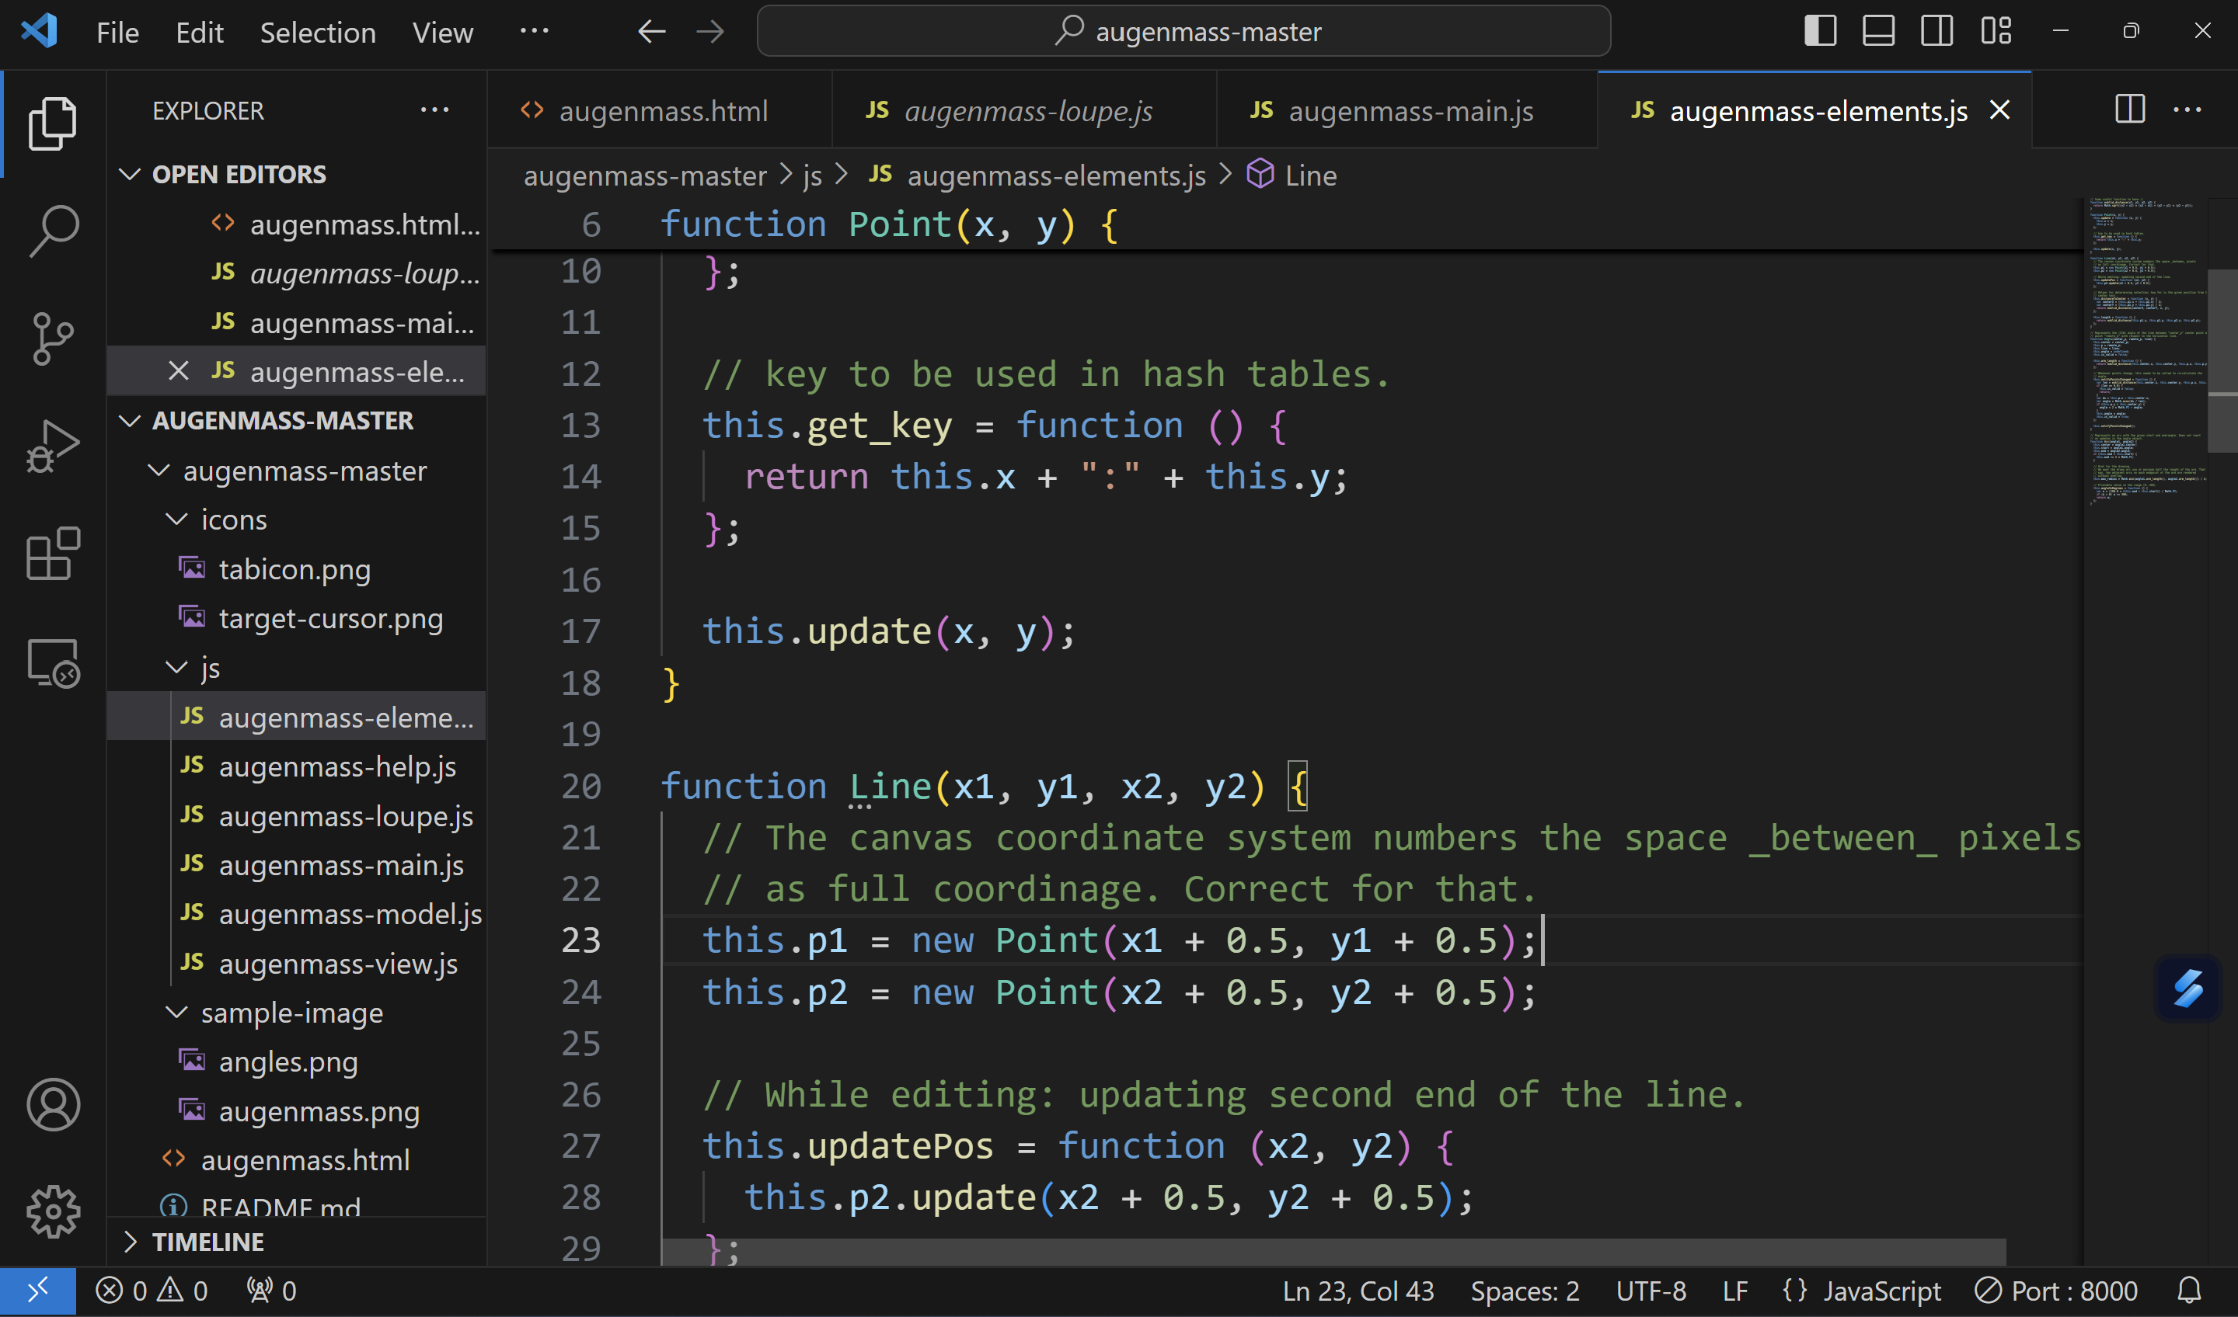
Demonstration
Planned Future UI
Dimensional Analysis Model

Slide 18
Project plan for completion of prototype and future enhancements
Codebase Integration:
Merge the dimensional analysis module and G-code generation module into a unified system, ensuring seamless data flow between the two processes.
Model Optimization:
Fine-tune the AI models to improve accuracy in dimension prediction and enhance G-code generation efficiency for different CNC machines.
User Interface Development:
Build a user-friendly interface allowing users to upload 2D images and receive optimized G-code outputs, ensuring a smooth user experience.
Prototype Testing & Validation:
Test the integrated solution with real-world datasets, ensuring accuracy in predictions and G-code generation across various object types.
Performance Refinement:
Resolve any bugs, improve processing speed, and optimize the G-code output for material efficiency and precise tool paths.
Final Prototype Release:
Complete the working prototype, incorporating feedback, and ensure it is fully functional for demonstration purposes.
Documentation & Demo Preparation:
Prepare detailed user documentation and create a final presentation for the demo day, showcasing the solution’s capabilities and benefits.

